Slide 1
Python – Introduction
AROCKIA ARULNATHAN A | www.arock.in | @aaa_nathan
Code : https://bitbucket.org/arock_nathan/python-training-material/src

Slide 2
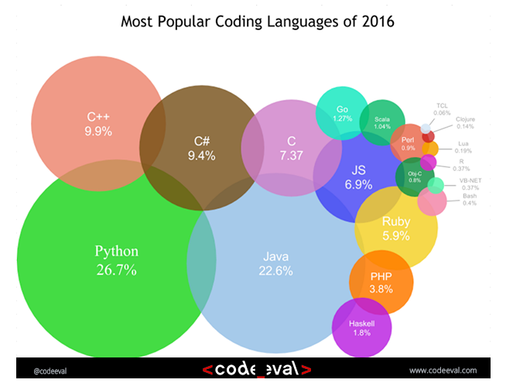
Expectations:
High level Introduction
Syntax explanation
Scripting Introduction – DataTypes /Controls and Loops/ OOP
Basic Python Scripting
Web Scraping – Automation
Debugging
Some inspiring scripts
Module Dev & Publish in Pypi

Slide 3
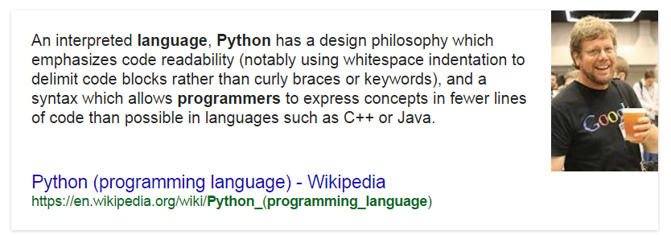
High level intro
Interpreted Language
Code readability
RAD
Huge collection of modules
Wide range of possibilities

Slide 4






High level intro - Cont.
Major Internet sites using Python:
Areas of Usage:
Network Scripting
Web & CGI
Mobile Application
Analytics
Data Processing
Scientific and Numeric Computing
Gaming
GUI
Automation Testing
Home Automation - RaspberryPi
Hacking – Exploit Development
ERP

Slide 5
High level intro - Cont.
Interoperability with other languages
Programming Language | Binding Generators / Wrappers
Java | Jython
C/C++ | Cython
C#/.Net | IronPython
Ruby | Rpy
Perl | PyPerl

Slide 6


Syntax explanation
Indentation is a single rule to follow the syntax. That’s it.
By default indentation should be 4 spaces for each code block but the same can be any number of spaces but the number of spaces for a single code block should be exactly same. Here there is no curly braces to separate the block.
def sample():
print “First Line”
print “Second Line”
def sample():
print “First Line”
print “Second Line”

Slide 7
scripting Introduction
Variable Types | Number | String | List | Dictionary | Tuple | DateTime | File
Decision Making | If |  | Else |  | Nested If…else
Loops | While |  | For
Classes & Objects | Class |  | Object |  | Inheritance |  | Overloading
Procedural Execution
No compilation
No explicit memory handling – Automatic garbage collection
Multiprocessing
Custom modules & package
Native installer conversion – scripts can be converted in to exe and binaries
If you are familiar other programming or scripting languages, nothing new here… Pleas bare with me ☹

Slide 8
Basic python scripting
Program
Output

Slide 9
Basic python scripting - Cont.
Important modules to get hands on
Module Name | Description
os | To access operating system level functionalities.
Datetime | To work with system time and date.
Csv, xlrd, json | To wok with csv files and xls files
Requests | To initiate HTTP requests. Will be helpful when you deal with REST calls.
BeautifulSoup, lxml | Will be useful when there is a need for parsing DOM
Collections | To deal with Set and collections.
Tkinter | To work with GUI.
Argparse | To work with command line arguments

